Slide 1




Phone Book by C
TEAM MEMBER:
Apsara Limbu (05)
Husnera Khatun (13)
Sangya Sakha (18)
Bimala Shahi (31)
Prashansa Hamal (35)

Slide 2
Introduction
Introduction to C Projects
It Introduces how to create a project in the C programming language, emphasizing the importance of practical implementation and problem solving skills .
Project Ideas
Various project ideas are suggested to help students understand the application of C programming concepts.
Basic Operations
The project involves operations such as adding, updating, and deleting contacts, which are fundamental tasks in many applications .
Function Implementation
Functions are crucial in structuring the code. Best practices include avoiding global variables and ensuring functions have clear arguments .
User Input Handling
The program is designed to take user input effectively, ensuring that the system can handle various data types and formats .
Data Management
Emphasis is placed on managing data efficiently, including storing and retrieving contact details, which is essential for any application dealing with user information .

Slide 3

Project Overview:
In this project you will find a very good implementation of file handling using C programming. Below are some overview of this app below are the topic which I implement in this project:
1)Serialization
2)Storing and retriving block of data into a file
3)Secure data by converting it into binary format
4)Pointers

Slide 4
Objectives
In this project we can save contacts and do these operations in it using file :
View all contacts.
Add a contact.
Remove a contact.
Search details of any contact number. ?
Update details of any contact.
Delete whole phonebook (delete all contacts present in phonebook)
Exits Phonebook

Slide 5

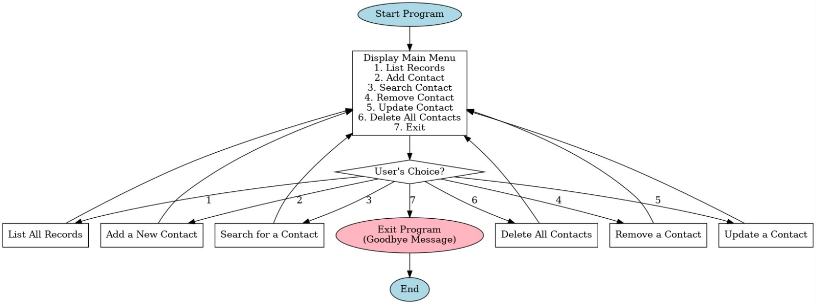
Flowchart

Slide 6
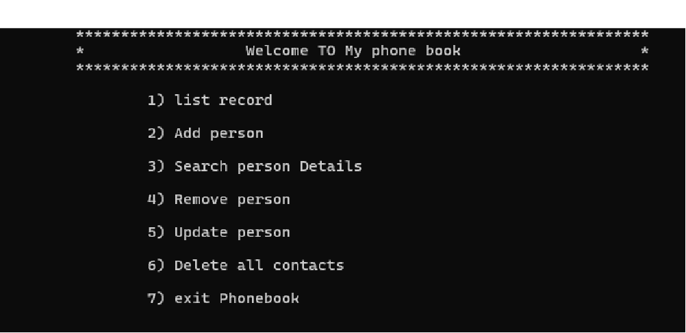
Front Interface
You can select operation you want to perform.?

Slide 7
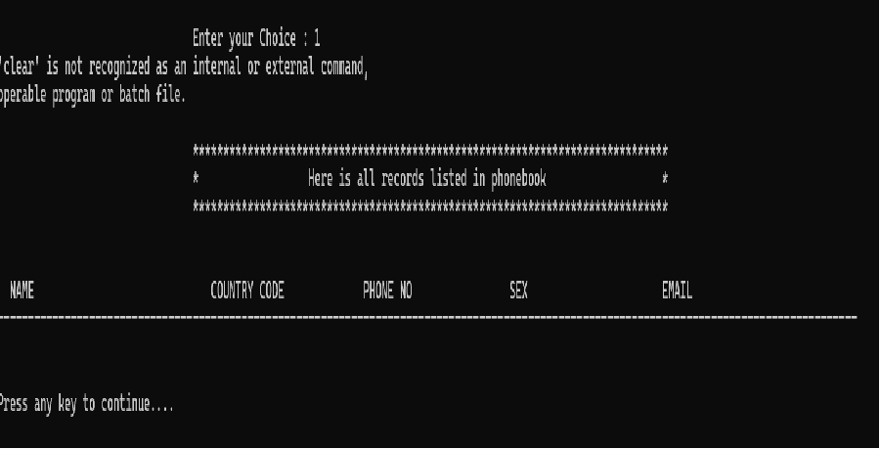
Listing data present in the phone book console app?

Slide 8
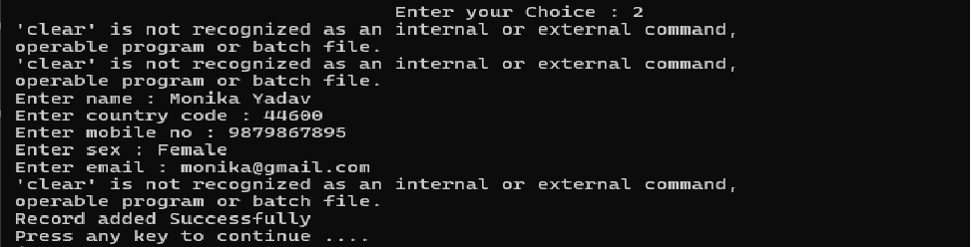
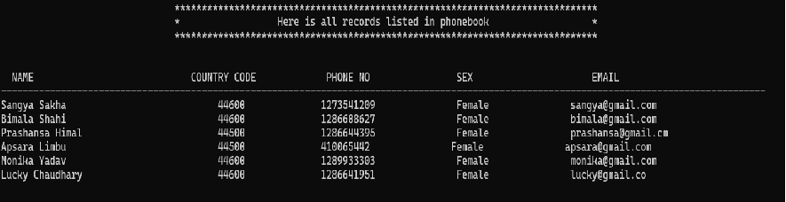
Adding data into the phone book?
you can easily add any number of data here

Slide 9
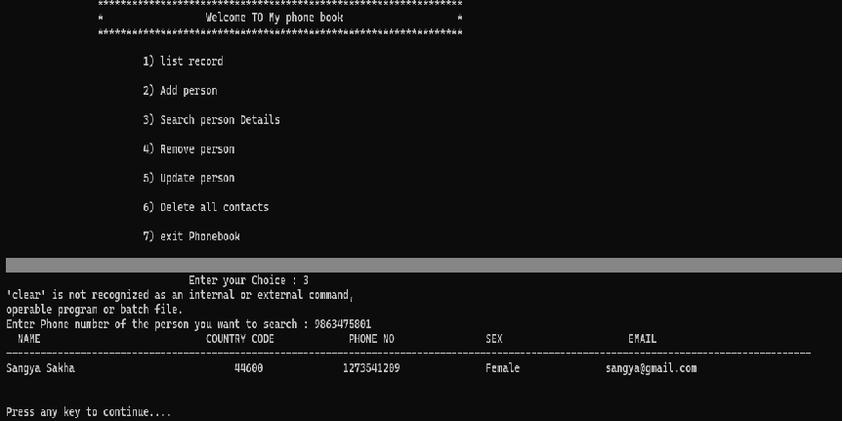
Searching by Phone number?
you can easily search between any detail present into the file

Slide 10
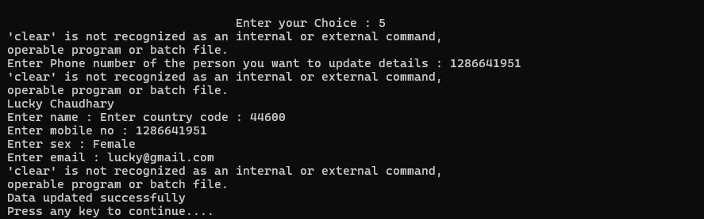
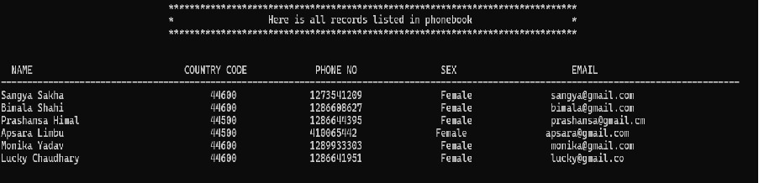
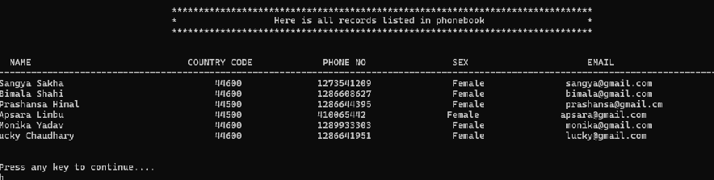
Outputs After updating the contact
Already saved list
After Update

Slide 11
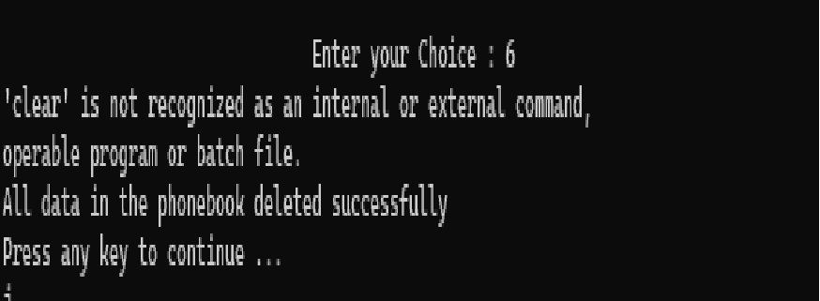
Delete whole phonebook(delete all contacts present in phonebook)

Slide 12
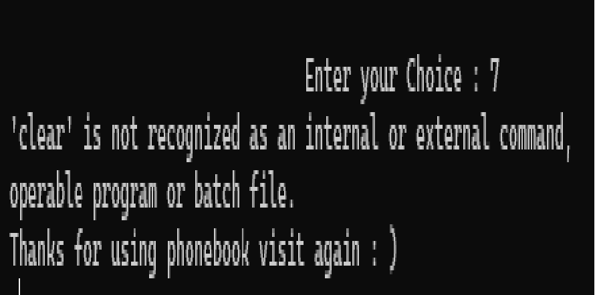
Exits Book Phone

Slide 13
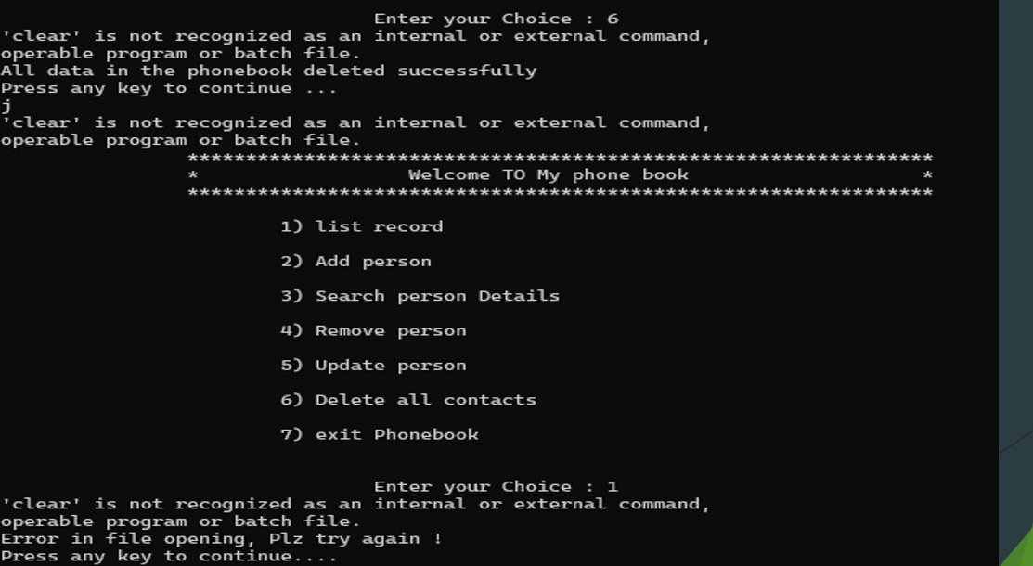
Error handling
Implementing error handling mechanisms ia crucial to ensure the program runs smoothly smoothly and can handel unexpected inputs

Slide 14
Summary /Conclusion?? ??
The summary of the project highlights the key aspects of developing a C language application, focusing on practical skills, user interaction, and data management In this project I will explain how you can make a project in c language. This project is loosely coupled project (one function is not depend on another one ).
I use these things in my project
Structures
File handling
String manipulation

